Slide 1
Text-to-Speech
Classical approach

Slide 2
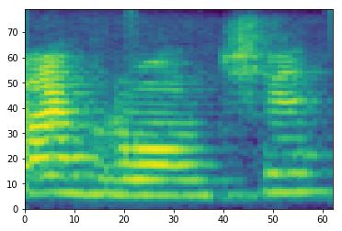
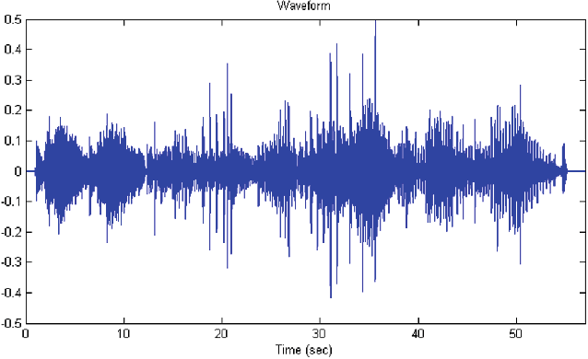
What is a TTS?
Text
Text Frontend
Acoustic Model
Vocoder
Text Normalization
Grapheme To Phoneme

Slide 3
Why it is so complicated?
Train two component separately
  Faster and easier
MelSpectrogram is smoother than waveform
Easier to train using MSE

Slide 4
Text Frontend
Text Normalization: Converting text into canonical form (e.g., “10 kg” → “ten kilograms,” “21.09” → “twenty-first of September”).
Grapheme-to-Phoneme Conversion (G2P): Conversion of written units (graphemes) into sound units (phonemes).

Slide 5
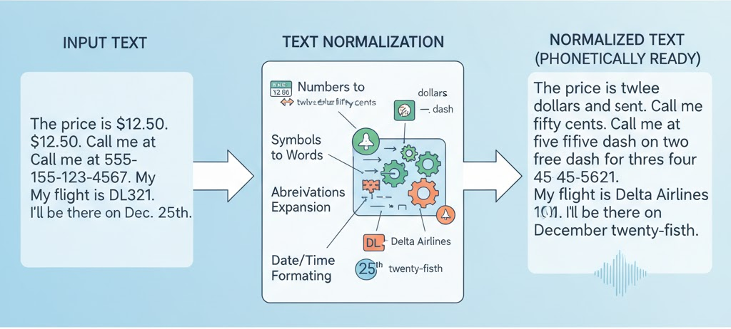
Text Frontend | Normalization
Rule-based & FST
Seq2Seq (Neural Networks)
Hybrid systems

Slide 6
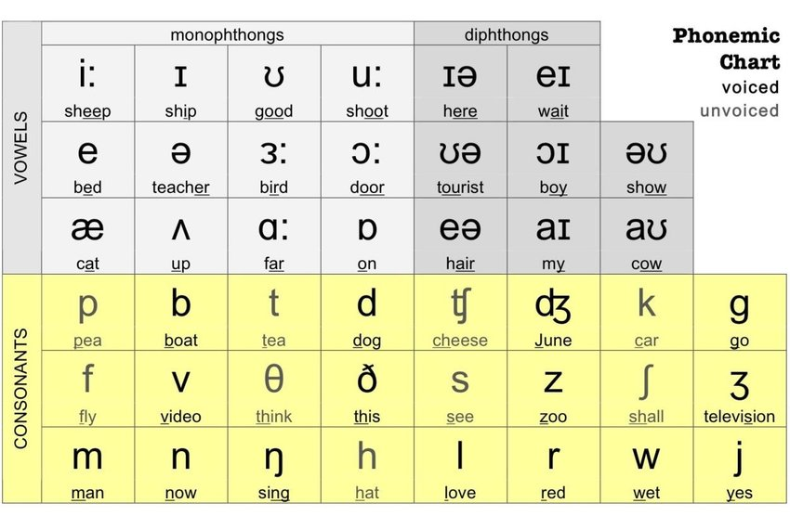
Text Frontend | G2P
Lexicon Lookup
Rule-based & FST
Seq2Seq (Neural Networks)

Slide 7
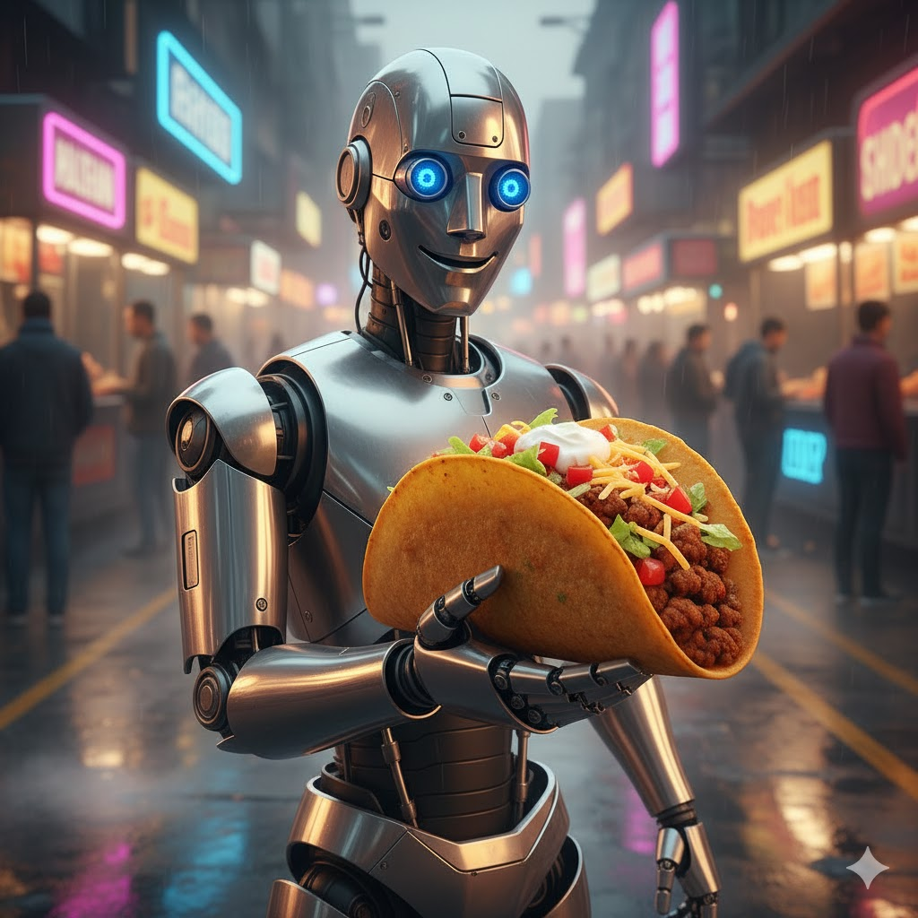
Tacotron 2
Text Encoder
Location Sensitive Attention
MelSpectrogram Decoder
Pre&Post Nets
MSE & CE criterions

Slide 8
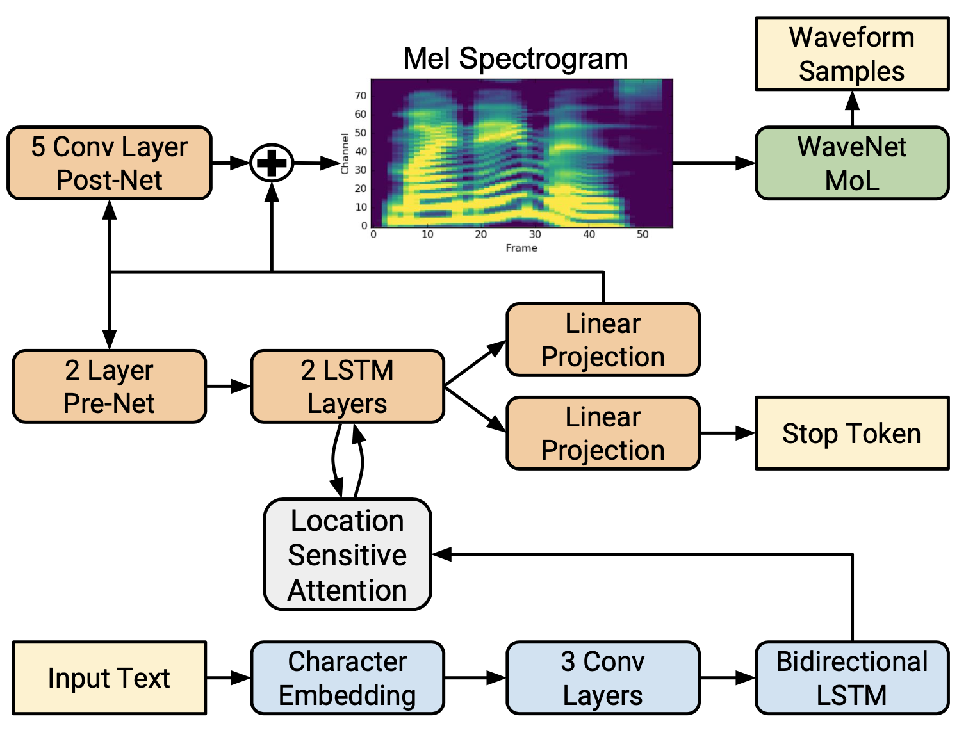
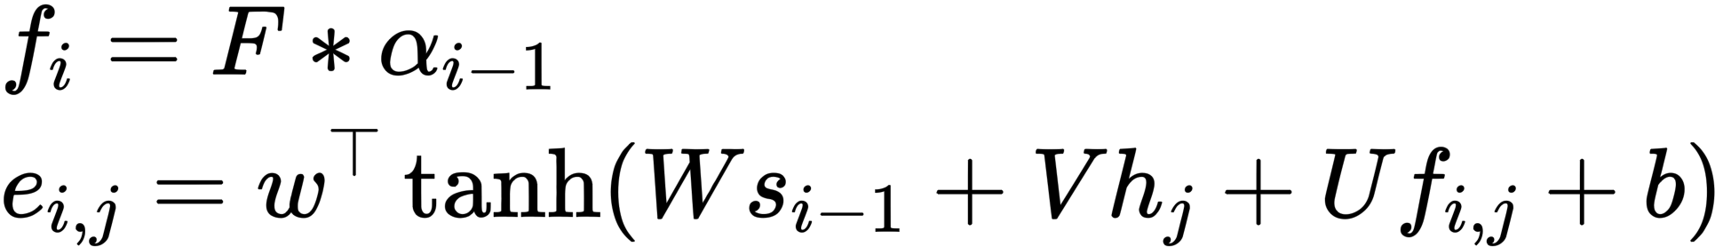
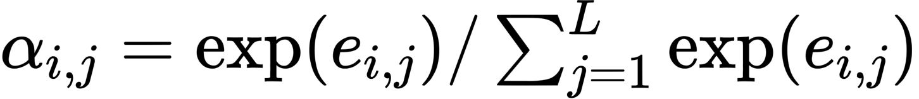
Tacotron 2
Pre-Net with Dropout
Post-Net for residual
LSA for easier attention learning
https://arxiv.org/abs/1712.05884

Slide 9
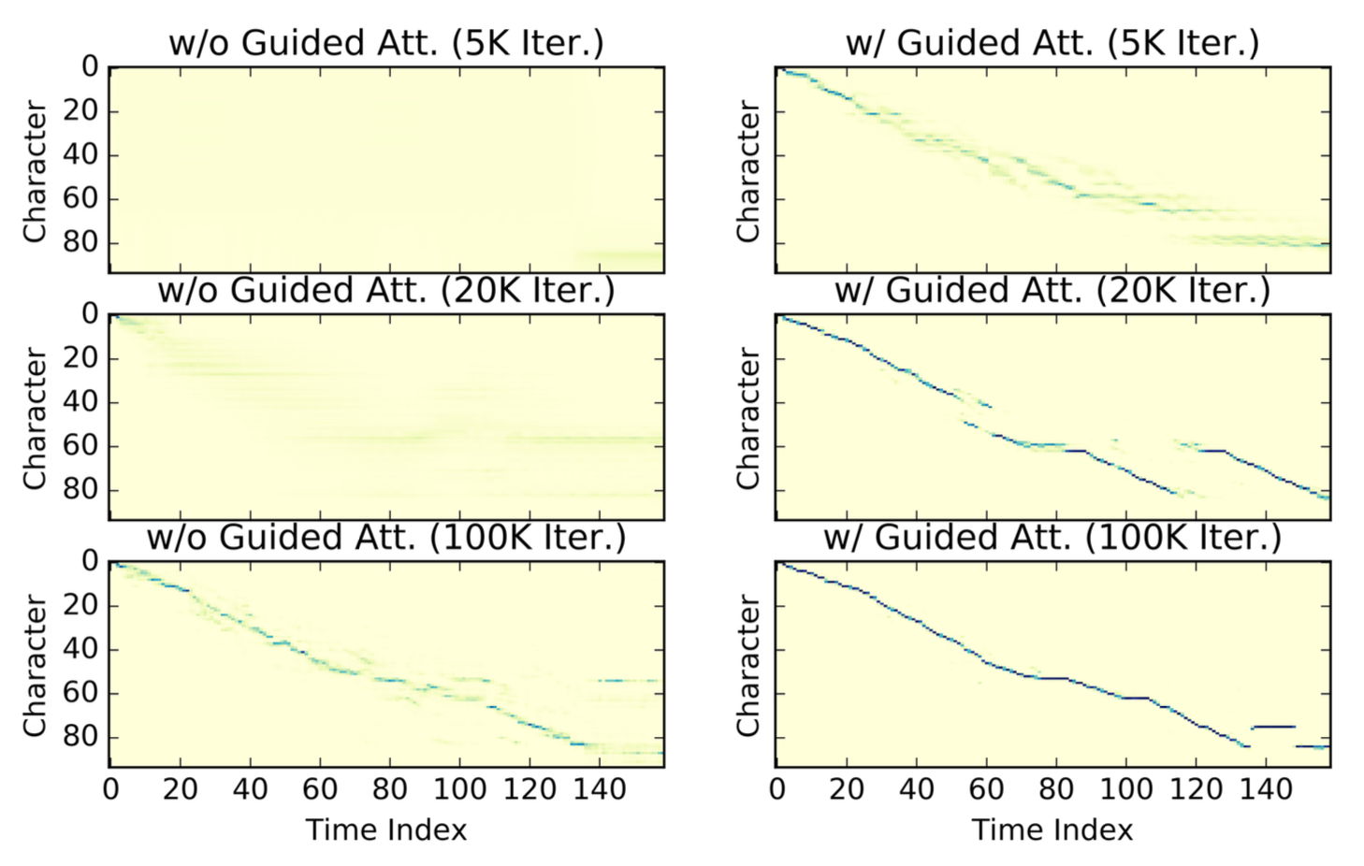
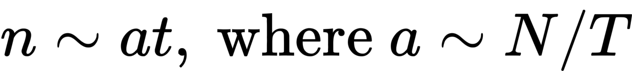
Guided Attention
Hard to learn attention from scratch
Text position n progresses linearly to time t:
Prompts attention matrix A to be “diagonal”
Similar ideas: monotonic attention
https://arxiv.org/pdf/1906.00672

Slide 10
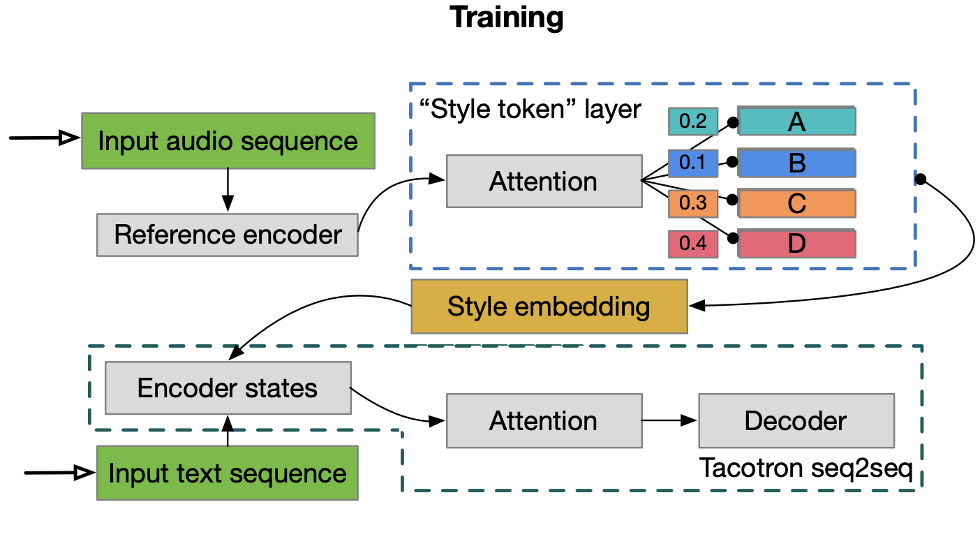
Global Style Token (GST)
https://arxiv.org/pdf/1803.09017

Slide 11
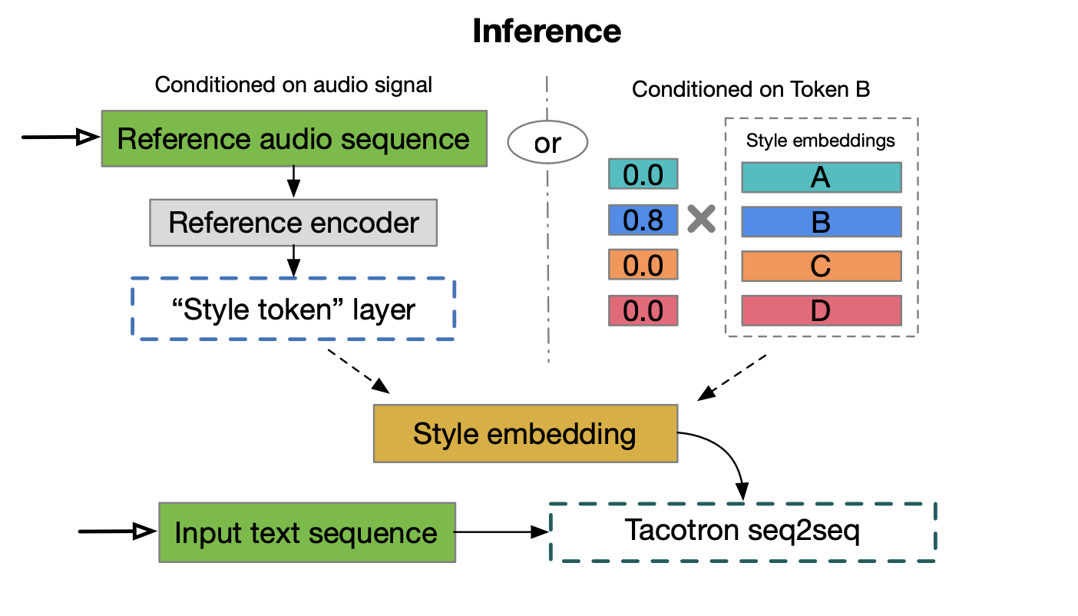
Global Style Token (GST)
https://arxiv.org/pdf/1803.09017

Slide 12
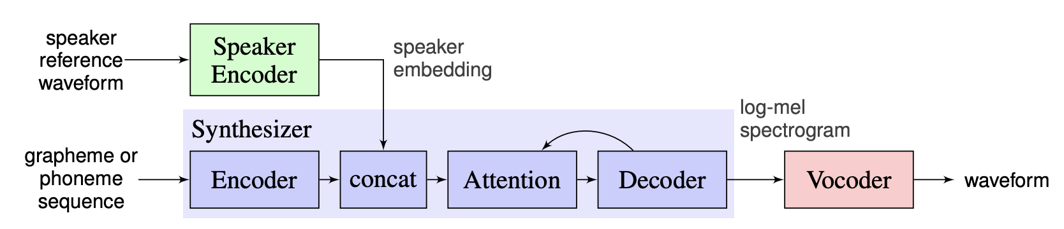
Multispeaker TTS
Speaker encoder (SE) trained on a speaker verification task
Text-independent task
Thousands of speakers

Slide 13
FastSpeech
Parallel Mel Generation
Feed-forward Transformer blocks
  1D Conv instead Linear
Duration predictor
Length Regulator
https://arxiv.org/abs/1905.09263

Slide 14
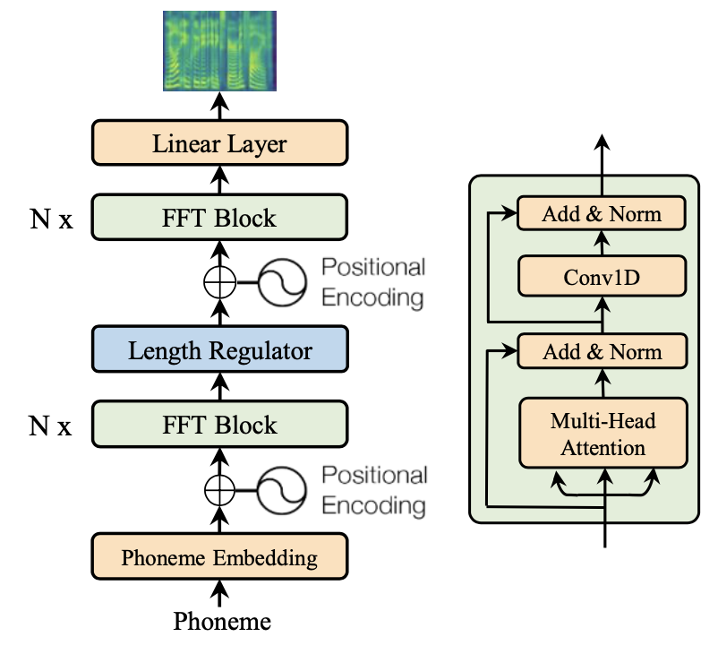
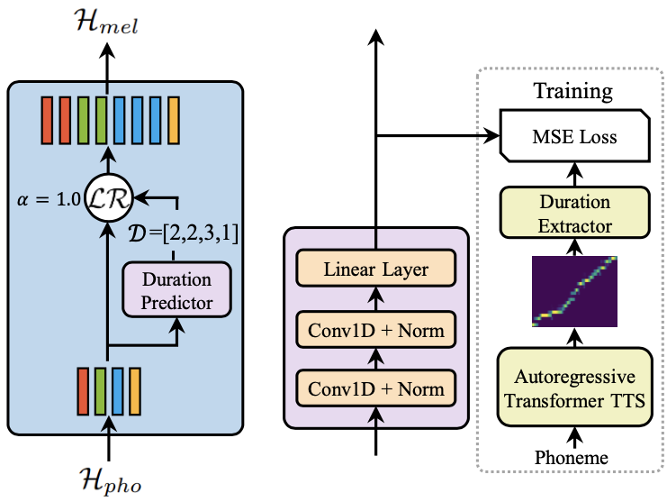
FastSpeech

Slide 15
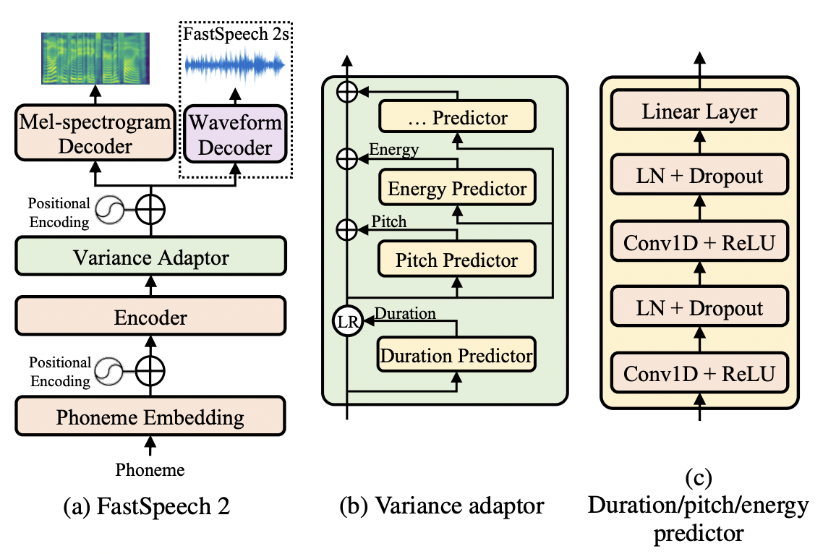
FastSpeech 2
Phoneme duration, which represents how long the speech voice sounds
Pitch, which is a key feature to convey emotions and greatly affects the speech prosody.
Energy, which indicates framelevel magnitude of mel-spectrograms.
https://arxiv.org/abs/2006.04558

Slide 16
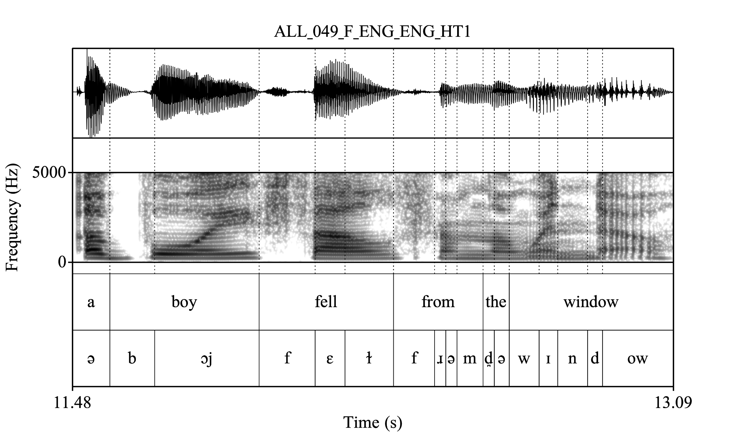
Montreal Forced Alignment
Feature Extraction (MFCC)
Modeling with Hidden Markov Models (HMM)
Search for most probable path
Multiple passes for speaker adaptation
https://montrealcorpustools.github.io/Montreal-Forced-Aligner/images/MFA_paper_Interspeech2017.pdf

Slide 17
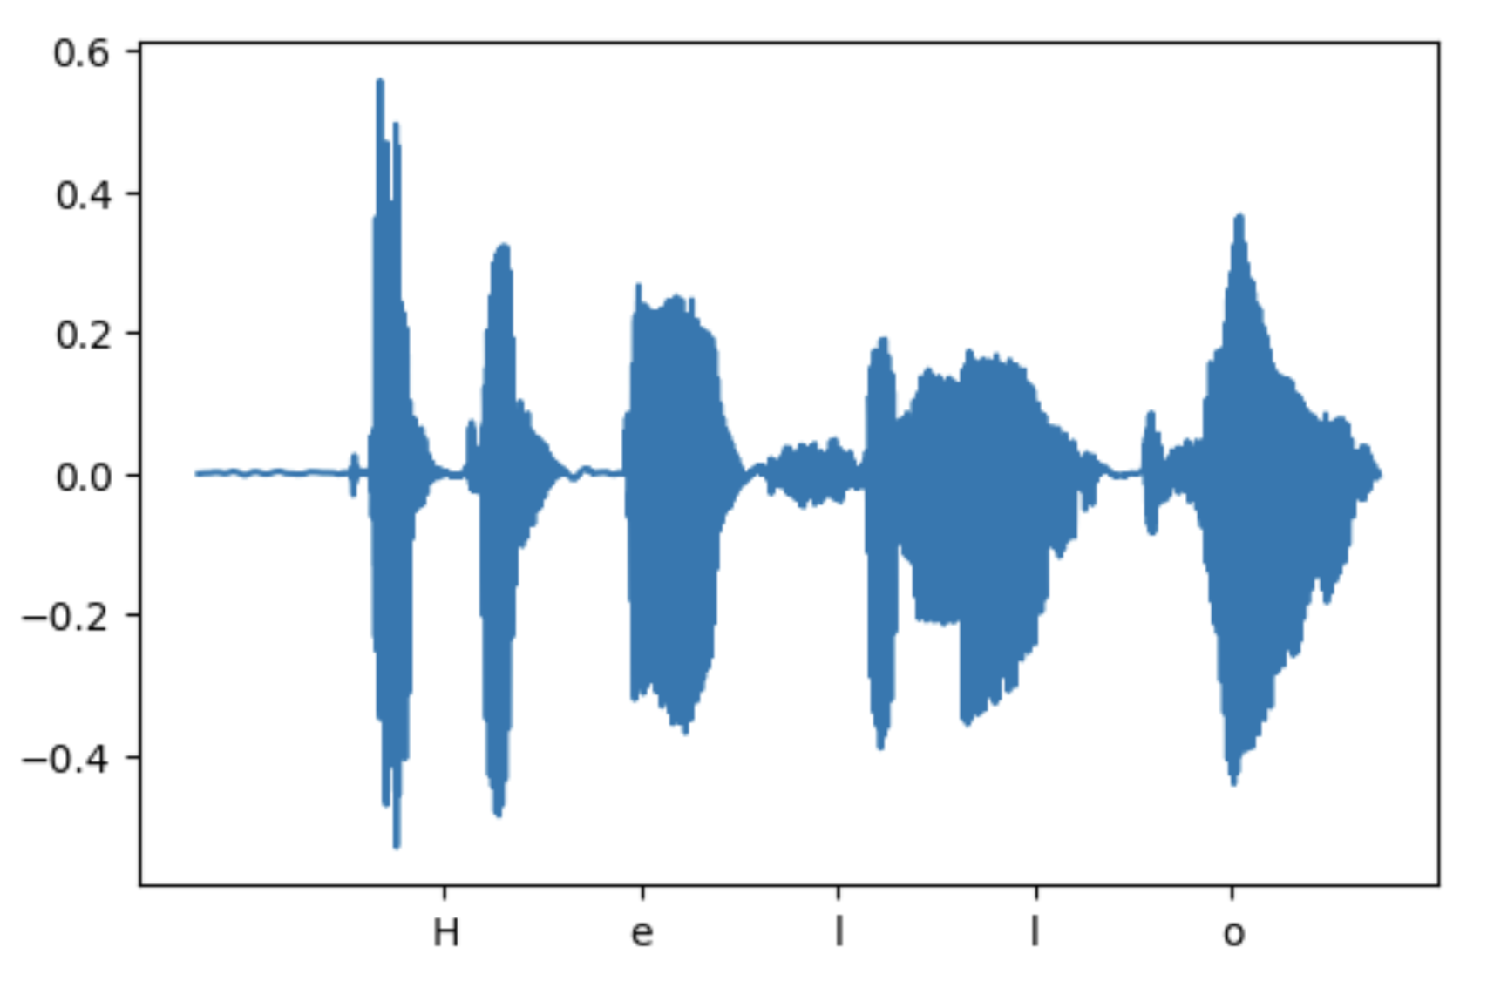
What about vocoders?
Vocoder

Slide 18
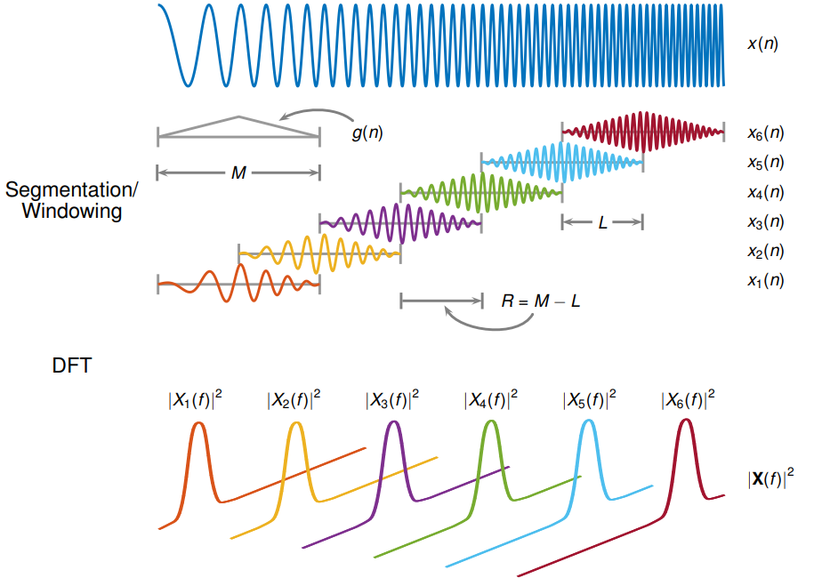
What is MelSpectrogram?
log(MelScale(x))

Slide 19
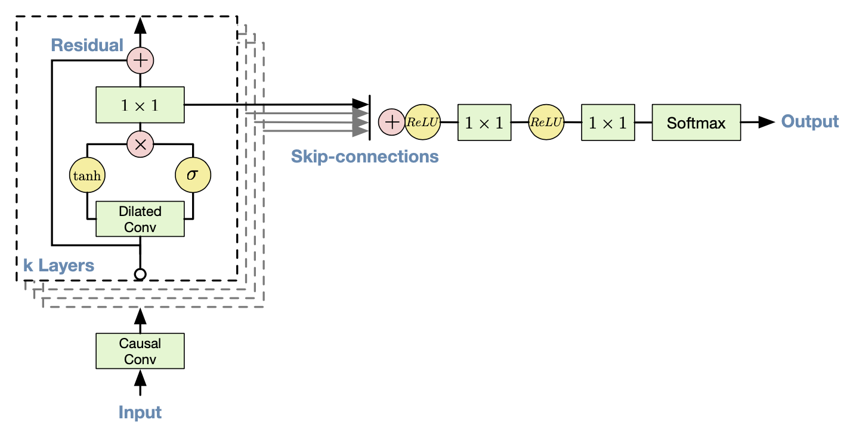
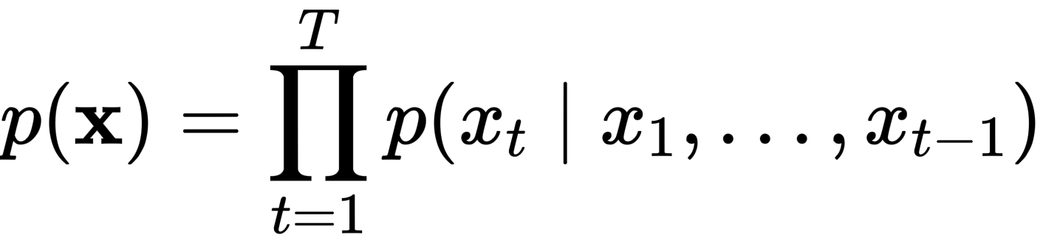
WaveNet
https://arxiv.org/pdf/1609.03499

Slide 20
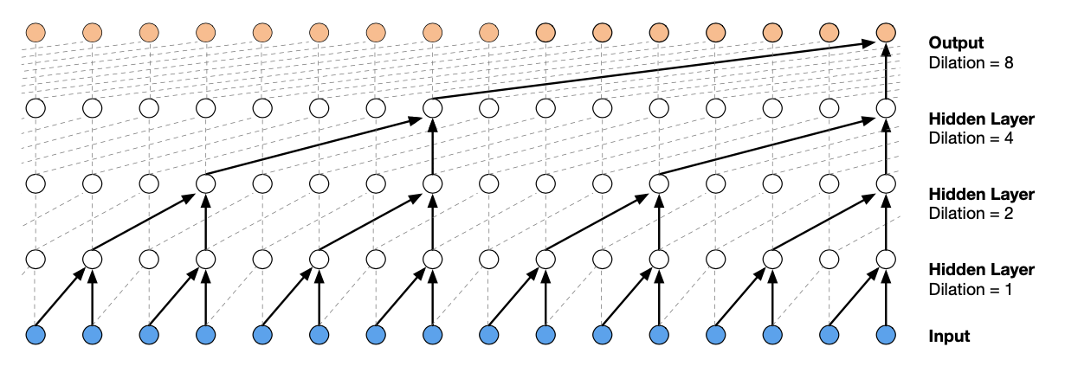
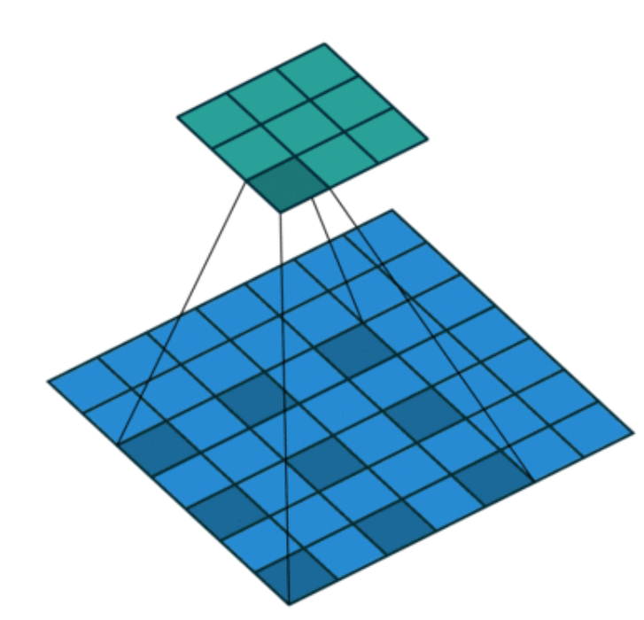
Dilated Causal Convolution
Increase receptive field
Allow modeling long time dependencies
Causal for avoiding looking in the future

Slide 21
Conditional WaveNet

Slide 22
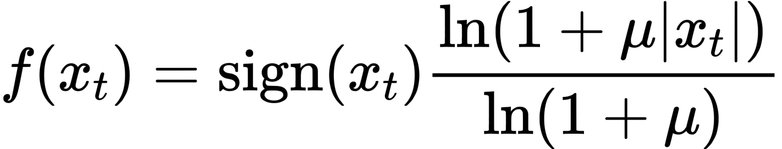
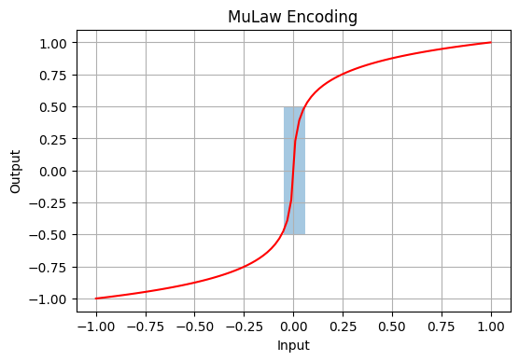
Mu Law Encoding
16-bit WAV contain 2^16 values
Softmax will die
Human hearing on a logarithmic scale
Low-amplitude sounds in high resolution
High-amplitude sounds in low resolution
http://educypedia.karadimov.info/library/YoungEngineering_ALaw_and_MuLaw_Companding.pdf

Slide 23
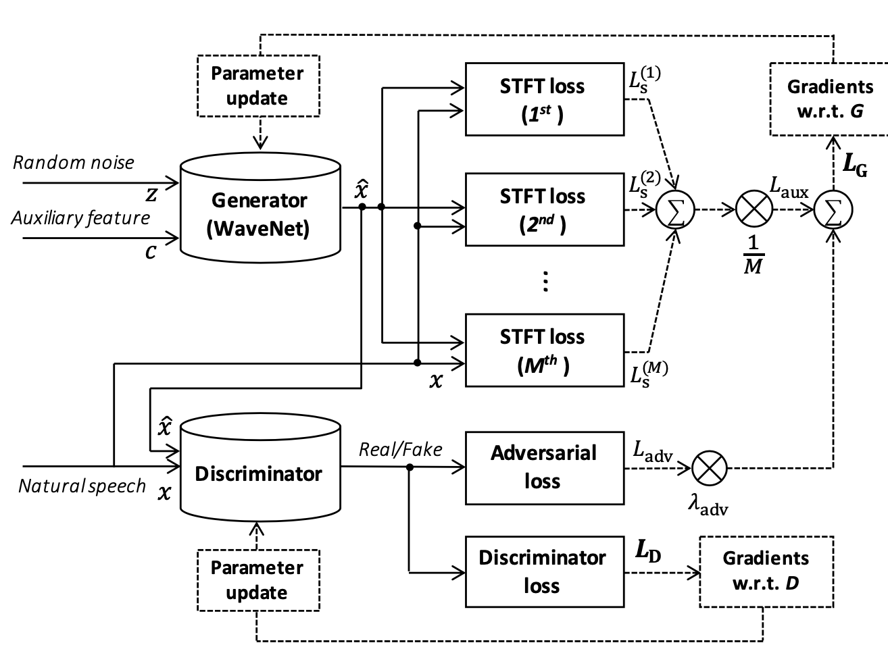
Parallel WaveGAN
Use WaveNet based Generator
Additionally use multi-STFT loss
https://arxiv.org/pdf/1910.11480

Slide 24
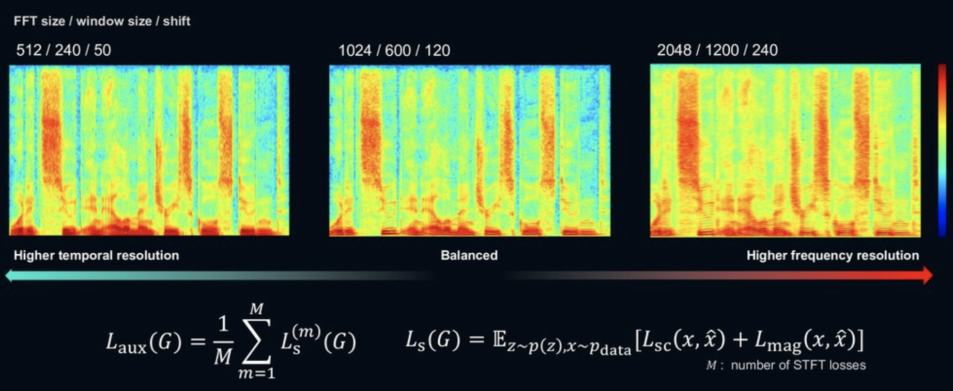
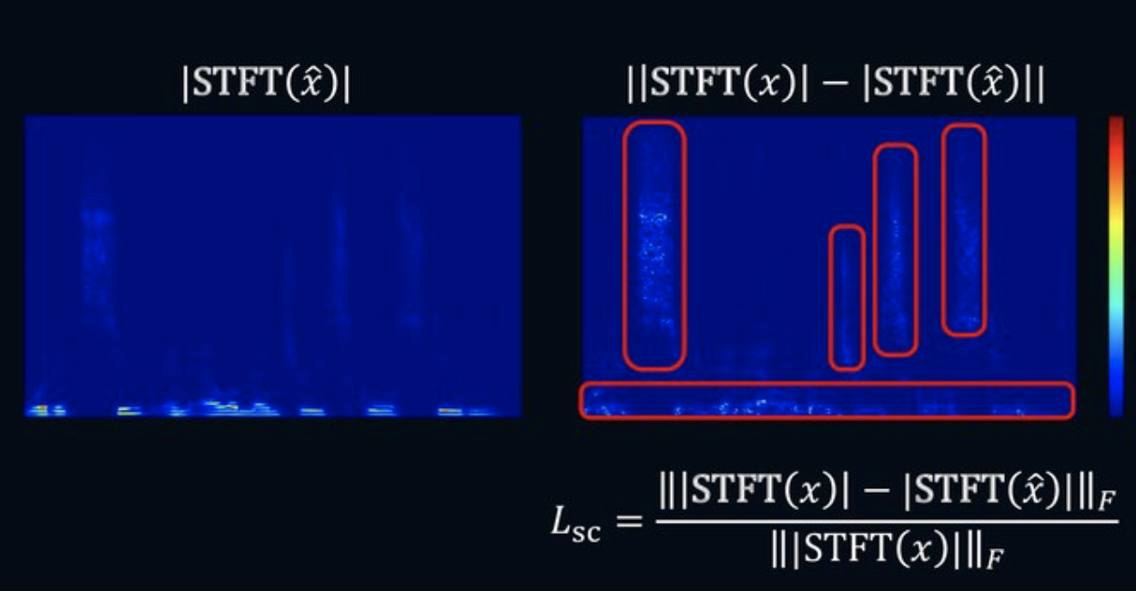
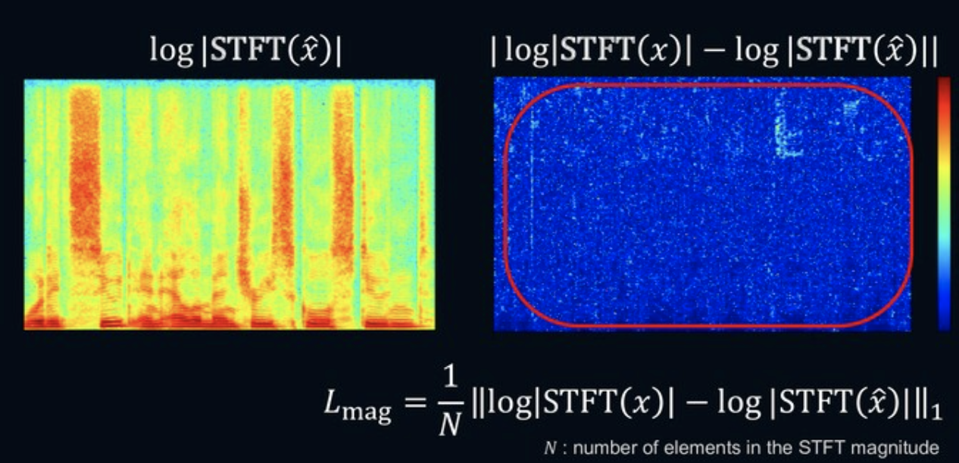
STFT Loss

Slide 25
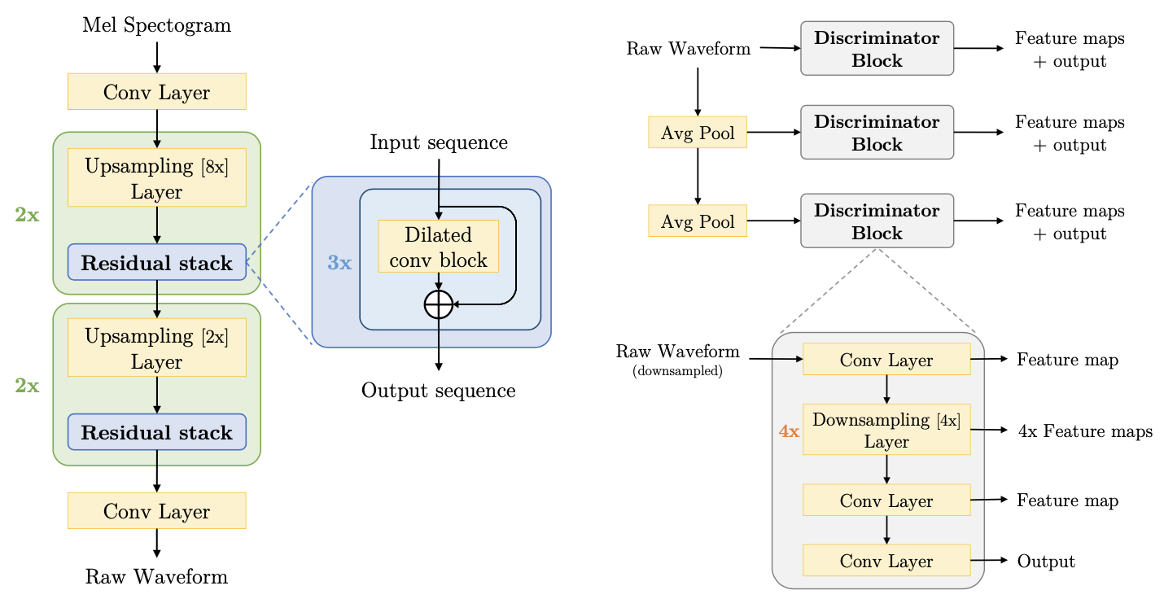
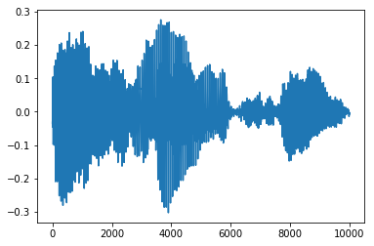
MelGAN
Non-autoregressive
Incredibly fast and don’t require any kind of distillation

Slide 26
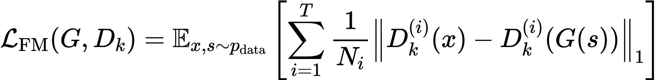
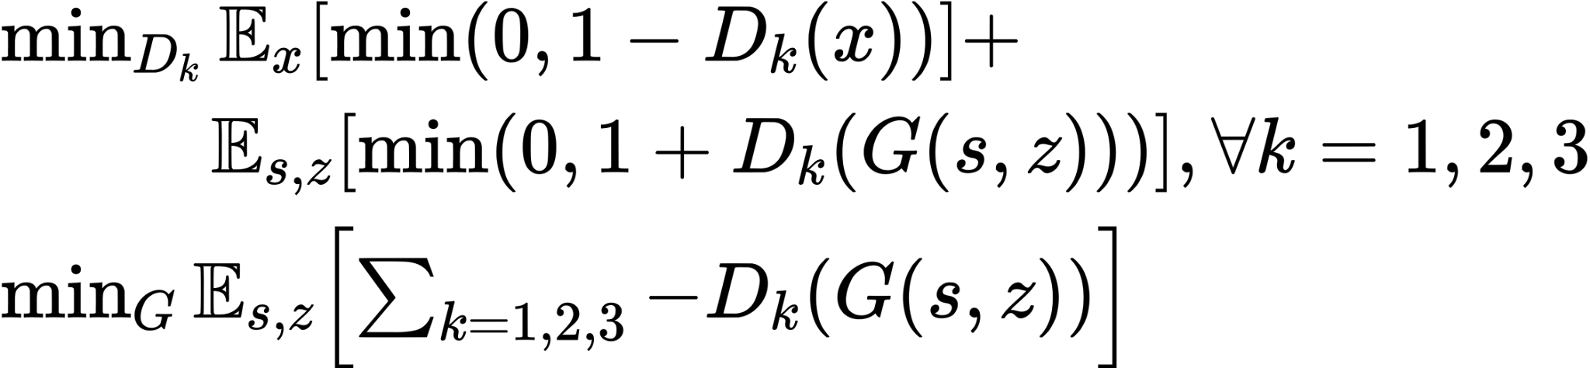
MelGAN
Multiscale discriminator
Feature Matching
Hinge Loss

Slide 27
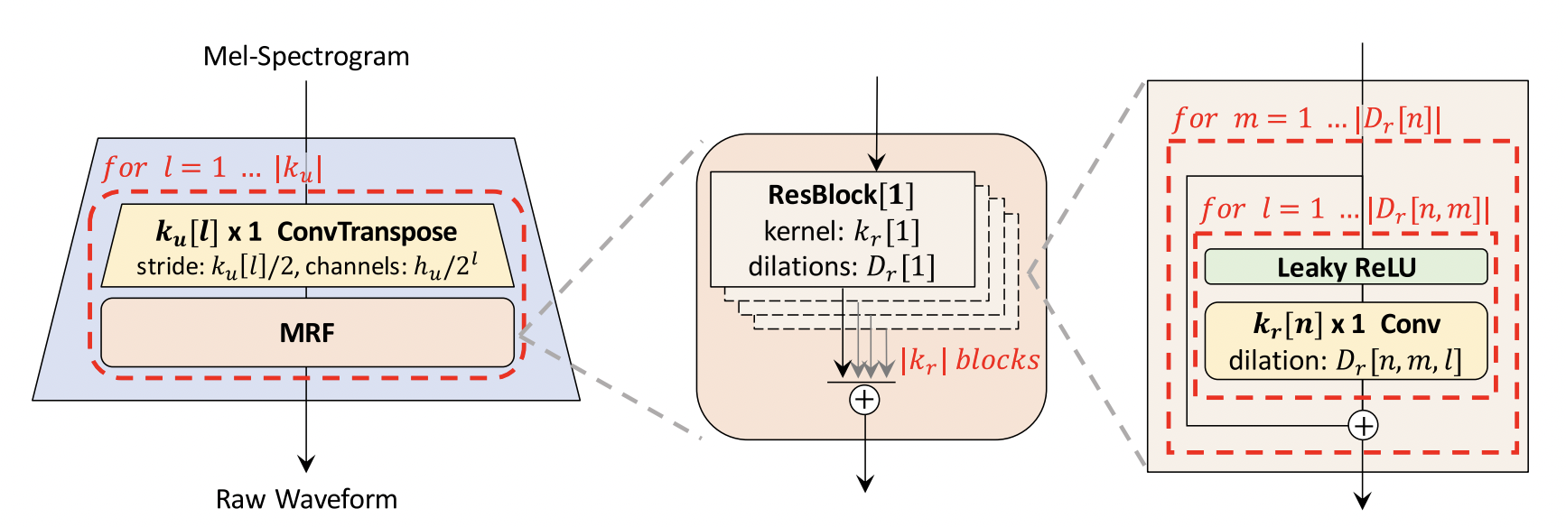
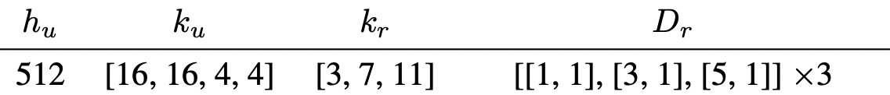
HiFi GAN
Generator
https://arxiv.org/pdf/2010.05646

Slide 28
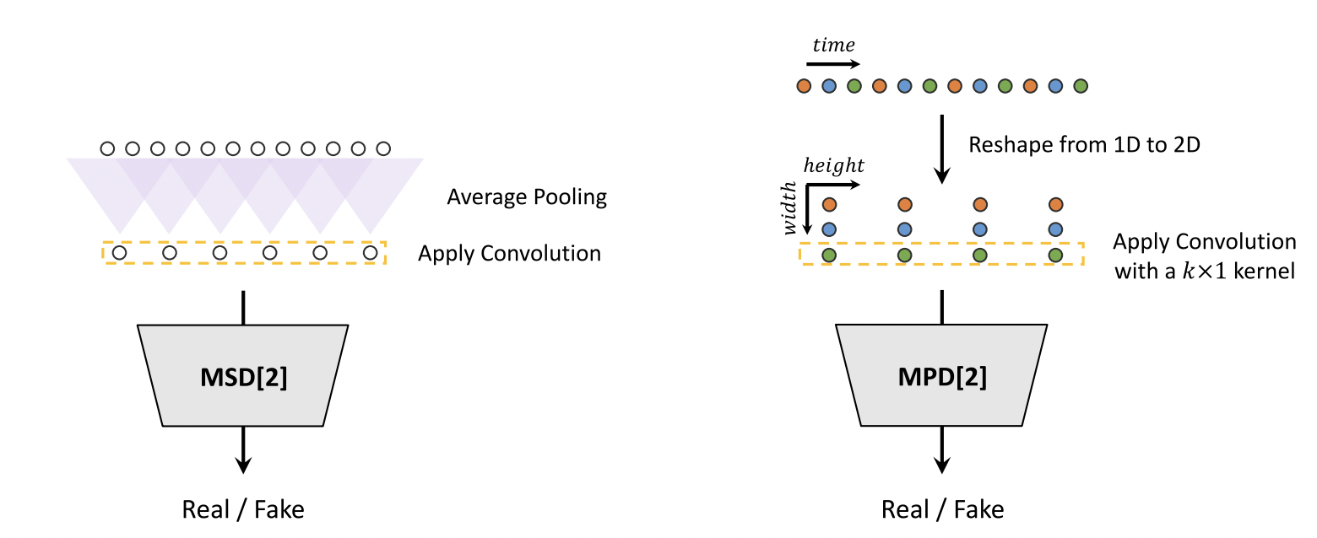
HiFi GAN
Discriminator

Slide 29
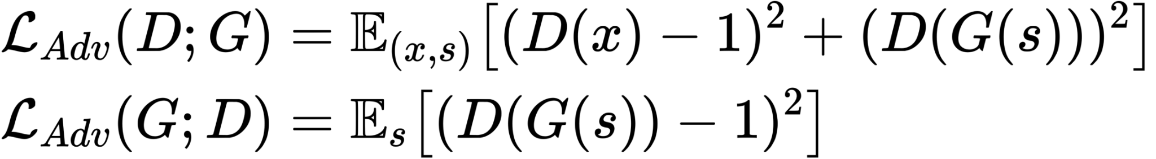
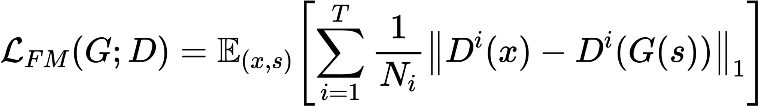
HiFi GAN
Criterions

Slide 30
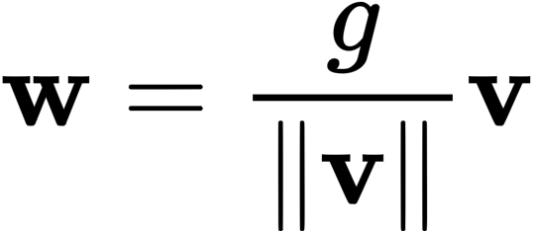
Weight Normalization
Low-cost calculations
Don’t store additional weight
Don’t have train/test domain gap in statistics
https://arxiv.org/pdf/1602.07868

Slide 31
How to Measure Quality?
There’s no correct answer
Subjective perception
A lot of types of mistakes

Slide 32
How to Measure Quality?
Overall impression
Intelligibility
Similarity
Naturalness
Pleasantness
Intonation and pauses
Emotions
Listening effort

Slide 33
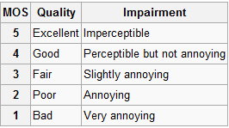
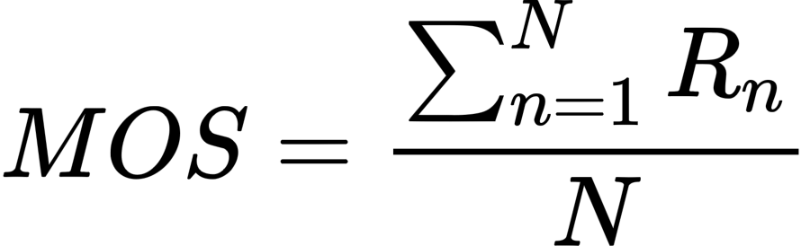
Mean Opinion Score (MOS)
Ask people to rate audio
Typically in the range from 1 to 5
Average scores

Slide 34
Mean Opinion Score (MOS)
Large variance due to human factor
Less variance more money
Hard to catch “hard” mistakes

Slide 35
MUSHRA
MUltiple Stimuli with Hidden Reference and Anchor
Explicit and hidden references
Calibration Anchors
Score range from 0 to 100
More stable than MOS

Slide 36
Side-by-Side
Compare pair of instances and choose more “preferable”
Answer is binary
Possibly evaluate small improvements
Sensitive to “hard” mistakes

Slide 37
Binary metrics
Answer if provided audio meets the condition
Answer is binary
Possibly evaluate small improvements

Slide 38

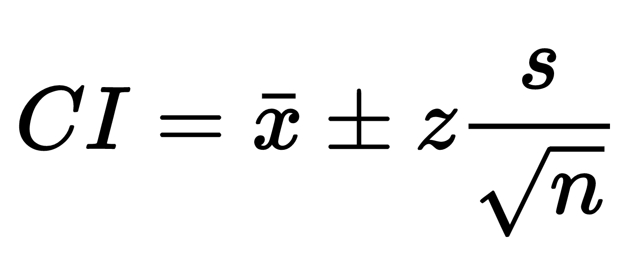
How to conduct measurements?
Crowdsourcing
Confidence intervals

Slide 39
What About Public Datasets?
LJSpeech
LibtiTTS
CommonVoice
OpenTTS (or analogs)
Custom vibes

Slide 40
Why do we still use classical approach?
Inference speed
Required data amount
Money
Controllability

